Slide 1


Noida Institute of Engineering and Technology, Greater Noida
WEB DEVELOPMENT USING MEAN STACK
Unit: 2
Express Framework
Ritesh Kumar Singh
(Asst. Professor)
CSE Department
Course Details (B. Tech. 6th Sem)

Slide 2
Faculty Introduction
Name | Ritesh Kumar Singh
Qualification | M. Tech.(CSE), PhD. Pursuing(CSE-Blockchain Technology)
Designation | Assistant Professor
Department | Computer Science & Engineering
Total Experience | 4.5 years
NIET Experience | 4 years
Subject Taught | Web development using python with Django, Problem Solving using Advance Python, Problem Solving using Python, Programming for Problem Solving using C, Database Management System.

Slide 3
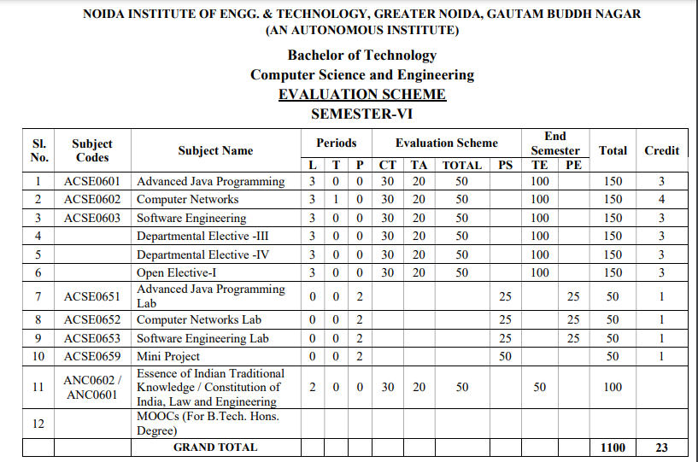
Evaluation Scheme

Slide 4
Syllabus
UNIT-I: Introduction to Nodejs
Installing Nodejs, Node in-built packages (buffer, fs, http, os, path, util, url)Node.js modules, File System Module,
Json data, Http Server and Client, Error handling with appropriate HTTP, Callback function, asynchronous
programing REST API’s(GET, POST PUT, DELETE UPDATE), GraphQL, Promises, Promise Chaining,
Introduction to template engine (EJS).

Slide 5
Syllabus
UNIT-II: Express Framework
Configuring Express, Postman configuration, Environment Variables, Routing, Defining pug templates, HTTP method of Express, URL binding, middleware function, Serving static files, Express sessions, REST full API’s, FORM data in Express, document modeling with Mongoose.

Slide 6
Syllabus
UNIT-III: Basics of Angular js
Typescript, Setup and installation, Power of Types , Functions Function as types Optional and default parameters, Arrow functions, Function overloading, Access modifiers, Getters and setters, Read-only & static, Abstract classes, Interfaces, Extending and Implementing Interface, Import and Export modules.

Slide 7
Syllabus
UNIT-IV: Building Single Page App with Angular js
MVC Architecture, One-way and Two-way data binding, AngularJS Expressions, AngularJS Controllers, AngularJS Modules, adding controller to a module, Component, Dependency Injection, Filters, Tables, AngularJS Forms and Forms validation, Select using ng-option, AngularJS AJAX.

Slide 8
Syllabus
UNIT-V: Connecting Angular js with MongoDB
Environment Setup of Mongo dB , data modeling ,The current SQL/NoSQL landscape, Create collection in Mongo dB, CRUD Operations in MongoDB. Mongo's feature set, Introduction to Mongoose, understanding mongoose schemas and datatypes, Connecting Angular with mongo dB using API.

Slide 9
Branch Wise Application
1. Real time web analytics
2. Digital Advertising
3. E-Commerce
4. Publishing
5. Massively Multiplayer Online Games
6. Backend Services and Messaging
7. Project Management & Collaboration
8. Real time Monitoring Services
9.Live Charting and Graphing
10. Group and Private Chat

Slide 10
Course Objective
In this semester, the students will
Study how to design and build static as well as dynamic webpages and interactive web applications
Students examine advanced topics like Angular, nodejs, Mongodb for web applications.
Also examine Express framework for interactive web applications that use rich user interfaces .

Slide 11
Course Outcomes (COs)
At the end of course, the student will be able to:
CO1 : Explain, analyze and apply the role of server-side scripting language like Nodejs .
CO2 : Demonstrate Express framework to design and implement dynamic web pages.
CO3 : Apply the knowledge of Typescript that are vital in understanding angular js.
CO4 : Analyze build and develop single page application using client-side programming.
CO5 : Understand the impact of web designing by database connectivity with Mongodb

Slide 12
Program Outcomes (POs)
Engineering Graduates will be able to:
PO1 : Engineering Knowledge
PO2 : Problem Analysis
PO3 : Design/Development of solutions
PO4 : Conduct Investigations of complex problems
PO5 : Modern tool usage
PO6 : The engineer and society

Slide 13
Program Outcomes (POs)
Engineering Graduates will be able to:
PO7 : Environment and sustainability
PO8 : Ethics
PO9 : Individual and teamwork
PO10 : Communication
PO11 : Project management and finance
PO12 : Life-long learning

Slide 14
COs - POs Mapping
CO.K | PO1 | PO2 | PO3 | PO4 | PO5 | PO6 | PO7 | PO8 | PO9 | PO10 | PO11 | PO12
CO1 | 2 | 2 | 3 | 1 | 3 | 1 | 1 | 1 | 3 | 2 | 3 | 3
CO2 | 2 | 2 | 3 | 1 | 3 | 2 | 1 | 1 | 1 | 1 | 2 | 3
CO3 | 2 | 2 | 2 | 2 | 2 | 1 | 1 | 1 | 2 | 1 | 2 | 2
CO4 | 2 | 1 | 2 | 1 | 2 | 1 | 1 | 1 | 1 | 1 | 2 | 2
CO5 | 2 | 1 | 3 | 2 | 3 | 1 | 1 | 1 | 3 | 2 | 3 | 3

Slide 15
Program Specific Outcomes(PSOs)
S. No. | Program Specific Outcomes (PSO) | PSO Description
1 | PSO1 | The ability to identify, analyze real world problems and design their ethical solutions using artificial intelligence, robotics, virtual/augmented reality, data analytics, block chain technology, and cloud computing.
2 | PSO2 | The ability to design and develop the hardware sensor devices and related interfacing software systems for solving complex engineering problems.
3 | PSO3 | The ability to understand inter-disciplinary computing techniques and to apply them in the design of advanced computing.
4 | PSO4 | The ability to conduct investigation of complex problems with the help of technical, managerial, leadership qualities, and modern engineering tools provided by industry-sponsored laboratories.

Slide 16
COs - PSOs Mapping
CO.K | PSO1 | PSO2 | PSO3 | PSO4
CO1 | 1 | 2 | 1 | 1
CO2 | 1 | 1 | 1 | 1
CO3 | 1 | 2 | 2 | 1
CO4 | 1 | 2 | 1 | 1
CO5 | 2 | 1 | 1 | 1

Slide 17
Program Educational Objectives (PEOs)
Program Educational Objectives (PEOs) | PEOs Description
PEOs | To have an excellent scientific and engineering breadth so as to comprehend, analyze, design and provide sustainable solutions for real-life problems using state-of-the-art technologies.
PEOs | To have a successful career in industries, to pursue higher studies or to support entrepreneurial endeavors and to face the global challenges.
PEOs | To have an effective communication skills, professional attitude, ethical values and a desire to learn specific knowledge in emerging trends, technologies for research, innovation and product development and contribution to society.
PEOs | To have life-long learning for up-skilling and re-skilling for successful professional career as engineer, scientist, entrepreneur and bureaucrat for betterment of society.

Slide 18
Result Analysis(Department Result & Subject Result & Individual result
Result Analysis By | Subject code | Result % of clear passed
Mr. Rahul Kumar | ACSE0614 | 98%

Slide 19
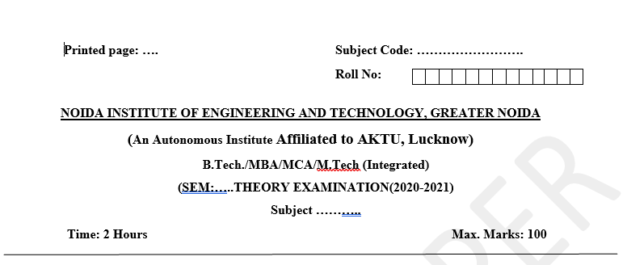
Pattern of Online External Exam Question Paper (100 marks)

Slide 20
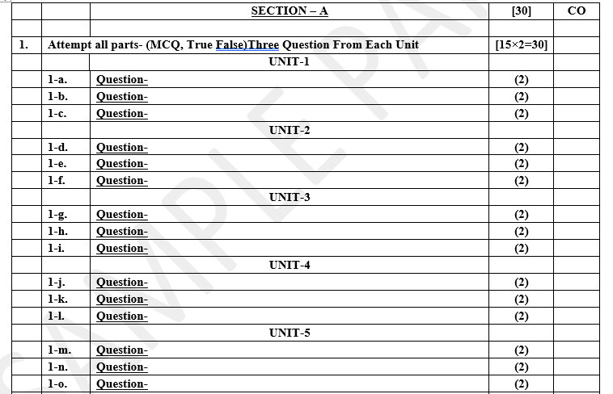
Pattern of Online External Exam Question Paper (100 marks)

Slide 21
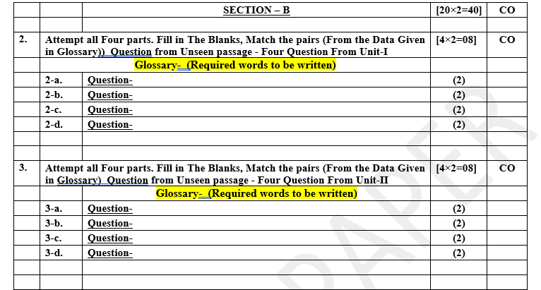
Pattern of Online External Exam Question Paper (100 marks)

Slide 22
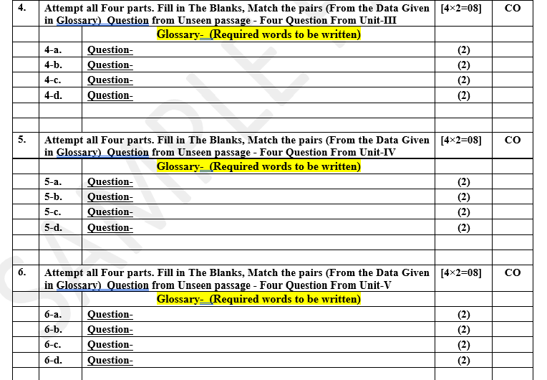
Pattern of Online External Exam Question Paper (100 marks)

Slide 23
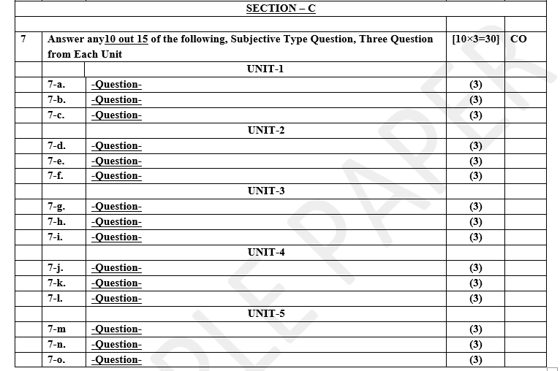
Pattern of Online External Exam Question Paper (100 marks)

Slide 24
Prerequisite / Recap
Student should have knowledge of Web technology and terminology.
Knowledge of HTML ,CSS and Java Script required .
knowledge of Programing language such as C/C++/Python etc.
Good problem solving Skill .

Slide 25
Brief Introduction about the Subject with videos
YouTube /Other Video Links
https://youtu.be/BLl32FvcdVM
https://youtu.be/v9ejT8FO-7I?list=PLrhzvIcii6GNjpARdnO4ueTUAVR9eMBpc
https://youtu.be/VGLjQuEQgkI?list=PLt4nG7RVVk1h9lxOYSOGI9pcP3I5oblbx

Slide 26
Unit II Content
Configuring Express, Postman configuration, Environment Variables, Routing, Defining pug templates, HTTP
Method of Express, URL binding, middleware function, Serving static files, Express sessions, REST full API’s,
FORM data in Express, document modeling with Mongoose.

Slide 27
Unit II Objective
In Unit II, the students will be able to find
Definitions of terms and concepts.
The idea of Configuring Express.
Routing, Defining pug templates.
HTTP method of Express, URL binding, middleware function.
Serving static files, Express sessions, REST full API’s,
FORM data in Express, document modeling with Mongoose.

Slide 28
Topic Objective
Topic : Configuring Express, Postman configuration, Environment Variables, Routing, Defining pug templates,
In this topic, the students will gain , how to install Express and POSTMAN . What are environment variables, routing and how to define pug templates.

Slide 29
MEAN STACK
MEAN .js is designed for the developers who want to design the dynamic website and web application using Mean.js.
The Mean.js can be considered a collection of various technologies for developing a dynamic website and web application.
Mean.js is used for developing a web application where MongoDB is used as a database system, Express.js is used as a back-end web framework, node.js is used as a web server, and Angular.js is used as a front-end framework.

Slide 30
Express.js
Express.js is a free and open-source software used as a back-end web application framework.
It is commonly used in the popular development stacks like MEAN with a MongoDB database.
The Express.js was developed by TJ Holowaychuk.
Express is a fast, assertive, essential and moderate web framework of Node.js.
We can assume express as a layer built on the top of the Node.js that helps manage a server and routes.
It provides a robust set of features to develop web and mobile applications.

Slide 31
Features of Express framework:
It can be used to design single-page, multi-page and hybrid web applications.
It allows to setup middlewares to respond to HTTP Requests.
It defines a routing table which is used to perform different actions based on HTTP method and URL.
It allows to dynamically render HTML Pages based on passing arguments to templates.

Slide 32
Use of Express.js
Ultra fast I/O
Asynchronous and single threaded
MVC like structure
Robust API makes routing easy

Slide 33
Advantages of Express.js
Advantages of Express.js
It is simple and lightweight software. It is not heavy to get installed in the machine and make the application running.
It is easy to customize and configure as we can see it provides the flexibility that we require.
It is a better choice for creating the API as when the application requires various APIs to communicate with different people then the Express.js is a good option..

Slide 34
Configure Express
Install Express.js
Use the following command to install express:
npm install express --save
The above command install express in node_module directory and create a directory named express inside the node_module.

Slide 35
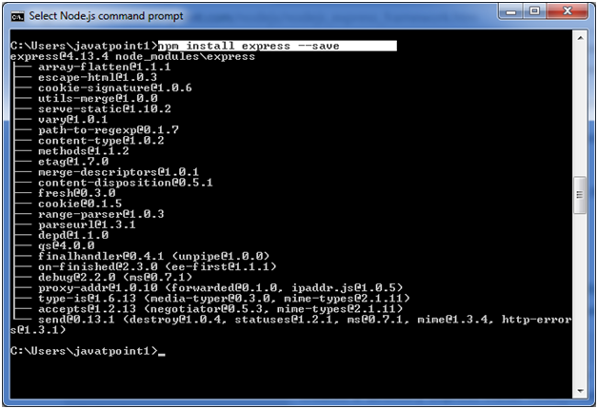
Configure Express Conti....

Slide 36
Configure Express Conti...
You should install some other important modules along with express.
Following is the list:
body-parser: This is a node.js middleware for handling JSON, Raw, Text and URL encoded form data.
cookie-parser: It is used to parse Cookie header and populate req.cookies with an object keyed by the cookie names.
multer: This is a node.js middleware for handling multipart/form-data.

Slide 37
Configure Express Conti...
body-parser: This is a node.js middleware for handling JSON, Raw, Text and URL encoded form data.
COMMAND:
npm install body-parser --save

Slide 38
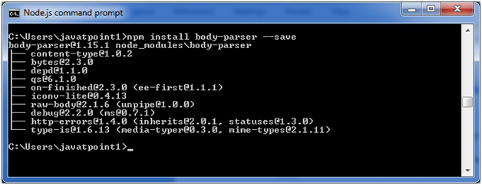
Configure Express Conti...

Slide 39
Configure Express Conti...
cookie-parser:
It is used to parse Cookie header and populate req.cookies with an object keyed by the cookie names.
COMMAND:
npm install cookie-parser --save

Slide 40
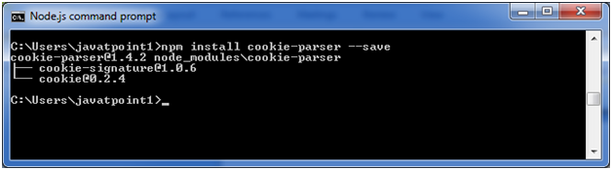
Configure Express Conti...

Slide 41
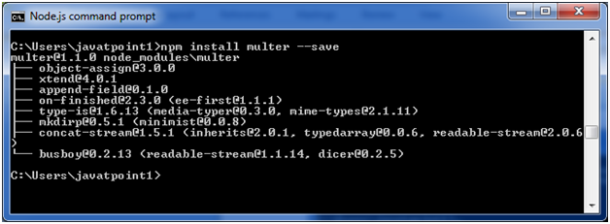
Configure Express Conti...
multer: This is a node.js middleware for handling multipart/form-data.
COMMAND:
npm install multer --save

Slide 42
Configure Express Conti...
multer: This is a node.js middleware for handling multipart/form-data.
COMMAND:
npm install multer --save

Slide 43
Postman
Postman:
Postman is a standalone software testing API (Application Programming Interface) platform to build, test, design, modify, and document APIs.
It is a simple Graphic User Interface for sending and viewing HTTP requests and responses.
While using Postman, for testing purposes, one doesn't need to write any HTTP client network code. Instead, we build test suites called collections and let Postman interact with the API.
In this tool, nearly any functionality that any developer may need is embedded.
This tool has the ability to make various types of HTTP requests like GET, POST, PUT, PATCH, and convert the API to code for languages like JavaScript and Python.

Slide 44
Features of Postman
Features of Postman:
Accessibility
Use Collections
Test development
Automation Testing
Debugging

Slide 45
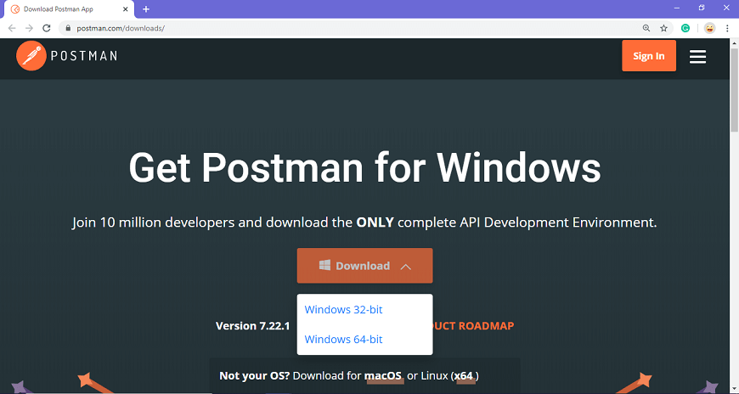
Postman Configuration
Steps to download and install the native Postman:
Step-1: Go to the link https://www.postman.com/downloads/ and click download for Mac or Windows based on your operating system.

Slide 46

Postman Configuration Conti....

Slide 47
Postman Configuration Conti....
Step-2: For downloading the app for Windows, click on the download button and select the particular version. I opted for the 64-bit version. If you are using a 32-bit OS, you can choose the 32 bit, as shown in the above image.
Step-3: You can check the download progress on the bottom left if you are using the Chrome browser. Once the .exe file is downloaded, you need to install the application, as shown in the below image.

Slide 48
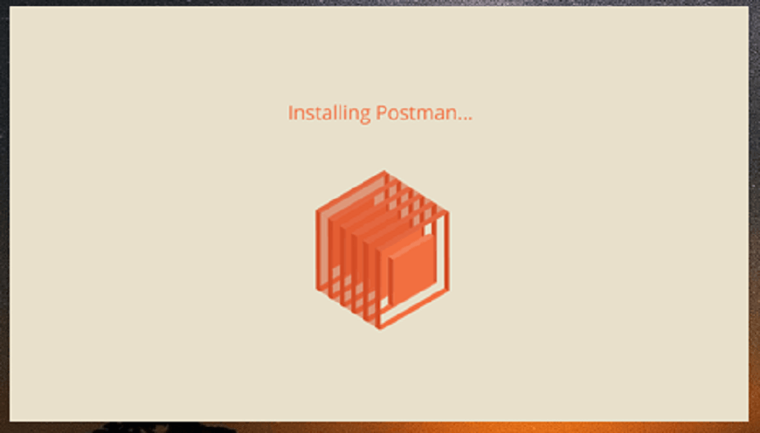
Postman Configuration Conti....

Slide 49
Postman Configration Conti.....
Step-4: Once the installation completes, you will be redirected to a window as shown in the image where you can click on Stop signing in and take me straight to the app (as this app can also be used without logging in) or otherwise you will get a new window to sign up.
Step-5: Create your account with all the required details, or you can also signup with Google, as shown in the image.

Slide 50
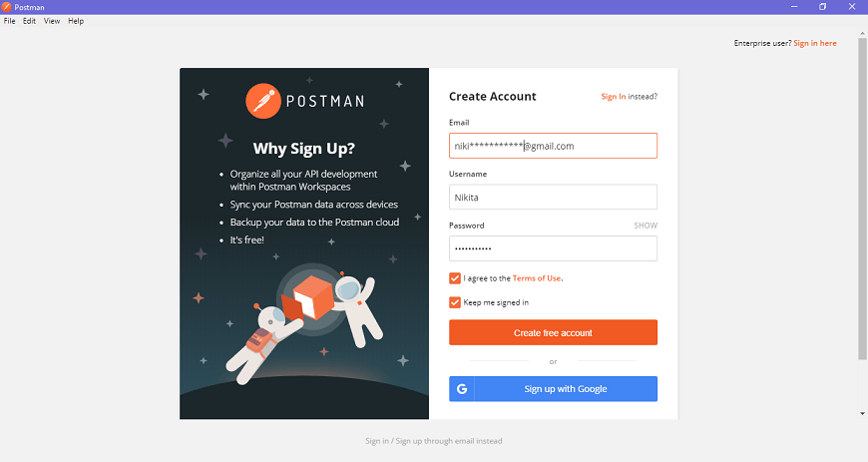
Postman Configuration Conti....

Slide 51
Postman Configuration Conti....
Step-6: After signing in, select the workspace tools as per your requirement, and then click on, continue to get the startup screen.

Slide 52
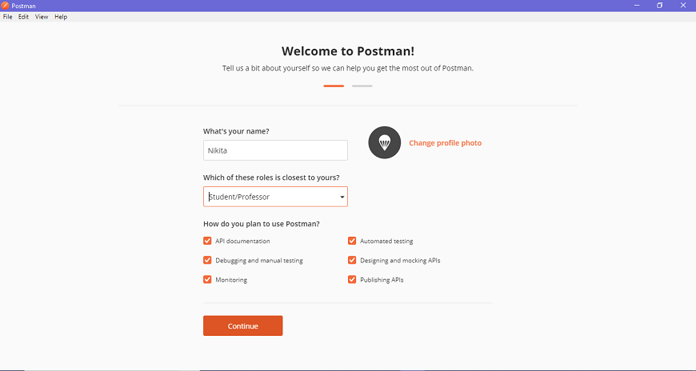
Postman Configuration Conti....

Slide 53
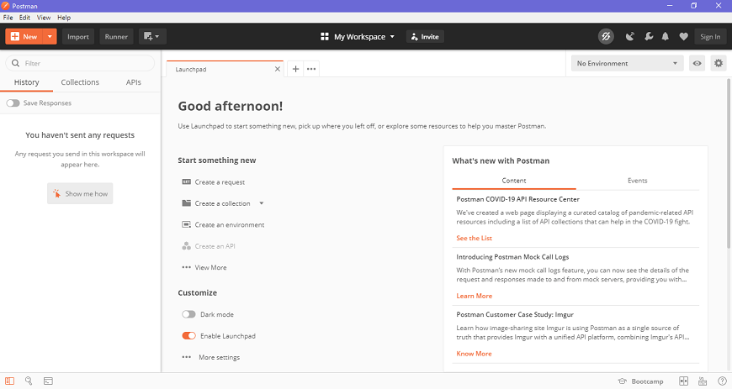
Postman Configuration
Step-7: You will see the following page, and then you are ready to use Postman.

Slide 54
Environment Variable
Environment Variable in Postman:
A collection of key-value pairs is called an environment.
Each name of the variable represents its keys. And referencing the name of the variable allows you to access its value.
It is a set of variables that differentiate among the requests. Such as, we can have an environment for testing, one for development and another for production.
We can change the value of the variables to pass the data between requests and tests.
Postman variables work in the same way as that of the programming variables. These are the symbols capable of taking various values.
You can store the values in variables and can use it throughout in requests, environments, collections, and scripts.
Variables in Postman increase the user's efficiency to work and decrease the errors.

Slide 55
Environment Variable
Types of EnvironmenVariables:
Local Variables
These are temporary variables that will only function inside the environment they were created in. When you change the environment, the variable will stop its access, and an error will occur.
Collection Variables
These are independent of environments and are available for all the requests in a collection.
Environment Variables
These are the most used variable scope in Postman. At a time, a single environment can be active. They are bound to a specified environment used to execute the request.
Global Variables
These are independent of environments and function outside the environment. Users are not required to create an environment for global variables. Through global variables, we can access data between collections, test scripts, requests, and environments.
Data Variables
Data variables come from external CSV and JSON files to define data sets

Slide 56
Environment Variable
Creating an Environment
To create an environment, follow the following steps:
Go to New -> Environment.

Slide 57
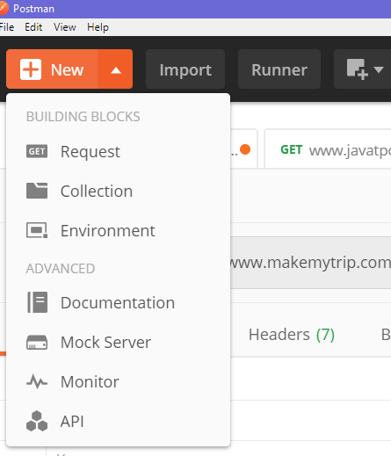
Environment Variable

Slide 58
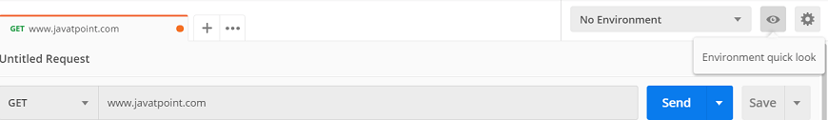
Environment Variable
Or you can create an environment from Environment quick look.
For that, click on Environment quick look button visible as an eye icon available in the top right corner of the builder section, as shown in the image below.

Slide 59
Environment Variable

Slide 60
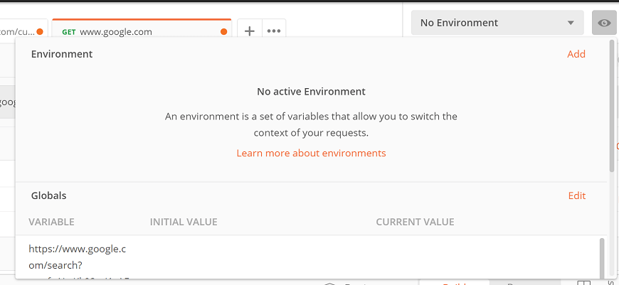
Environment Variable
Now select Add.

Slide 61
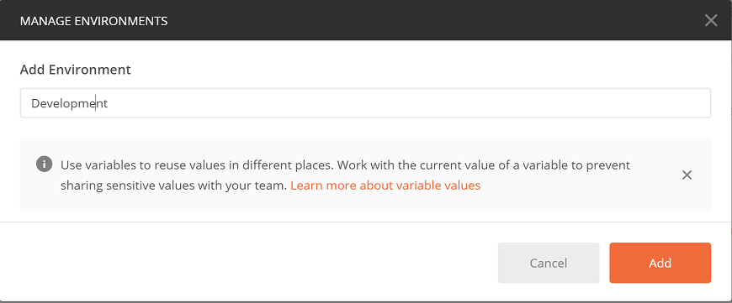
Environment Variable
Enter the name of the Environment and click on Add..

Slide 62
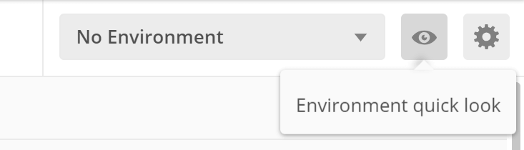
Environment Variable
Creating an Environment Variable:
To create an environment variable follow the following steps:
Go to Environment quick look button visible as an eye icon available in the top right corner of the builder section.

Slide 63
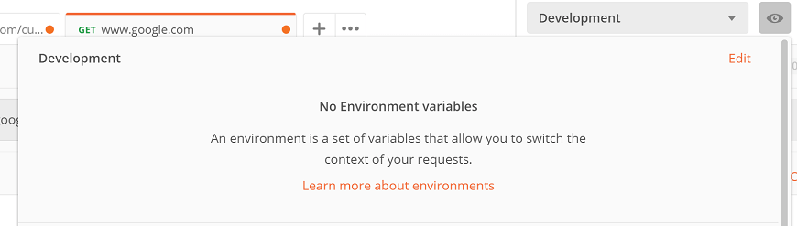
Environment Variable
Select the Edit option.

Slide 64
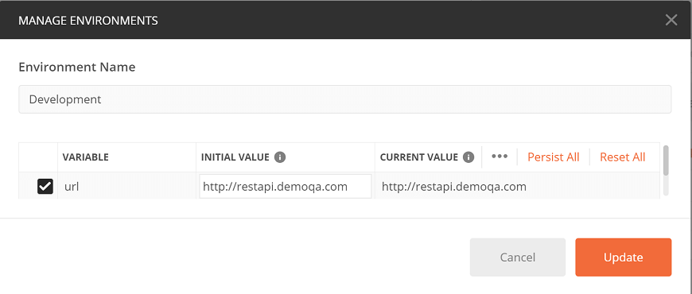
Environment Variable
Enter the below mentioned key-value pairs in which Key =url and Initial Value = http://restapi.demoqa.com.
Then select the Update button and close the Manage Environment window. Now you have an environment variable with the name 'url', and the value of the variable is the http://restapi.demoqa.com.

Slide 65
Environment Variable
Dynamic Variables :
Numbers, Texts and Colors
Variable Name
$randomAlphaNumeric: A random alphanumeric character
$randomInt: A random integer between 1 and 1000
$randomColor: A random color
$randomHexColor: A random hex value
$randomAbbreviation: A random abbreviation
$randomBoolean: A random boolean value like true or false
Address, Location, Phone
$randomCountry: A random country
$randomCountryCode: Random country code of two letters (ISO 3166-1 alpha-2)
$randomCity: A random city name
$randomStreetName: A random street name

Slide 66
Pug Template
Pug Template:
A template engine facilitates you to use static template files in your applications. At runtime, it replaces variables in a template file with actual values, and transforms the template into an HTML file sent to the client. So this approach is preferred to design HTML pages easily.
Express.js template engine
Pug template must be written inside .pug file and all .pug files must be put inside views folder in the root folder of Node.js application.
Note: By default Express.js searches all the views in the views folder under the root folder. you can also set to another folder using views property in express. For example: app.set('views','MyViews').

Slide 67
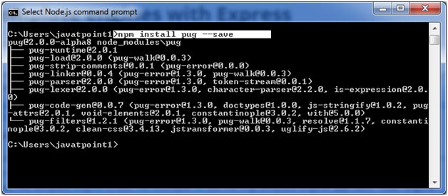
Pug Template
Install pug:
Execute the following command to install pug template engine:
npm install pug --save

Slide 68
Pug Template
Simple input:
doctype html
html
head
title A simple pug example
body
h1 This page is produced by pug template engine
p some paragraph here..
Output produced by pug template:
<!DOCTYPE html>
<html>
<head>
<title>A simple pug example</title>
</head>
<body>
<h1>This page is produced by pug template engine</h1>
<p>some paragraph here..</p>
</body>
</html>
Express.js can be used with any template engine. Let's take an example to deploy how pug template creates HTML page dynamically.

Slide 69
Pug Template
Create a file named index.pug file inside views folder and write the following pug template in it:
doctype html
html
head
title A simple pug example
body
h1 This page is produced by pug template engine
p some paragraph here..
File: server.js
var express = require('express');
var app = express();
//set view engine
app.set("view engine","pug")
app.get('/', function (req, res) {
res.render('view.pug', index);
res.render('index');
});
var server = app.listen(5000, function () {
console.log('Node server is running..');
});

Slide 70
Routing
Express.js Routing
Routing is made from the word route. It is used to determine the specific behavior of an application.
It specifies how an application responds to a client request to a particular route, URI or path and a specific HTTP request method (GET, POST, etc.). It can handle different types of HTTP requests.
Routing in ExpressJS is used to subdivide and organize the web application into multiple mini-applications each having its own functionality.
It provides more functionality by subdividing the web application rather than including all of the functionality on a single page.
These mini-applications combine together to form a web application. Each route in Express responds to a client request to a particular route/endpoint and an HTTP request method (GET, POST, PUT, DELETE, UPDATE and so on).
Each route basically refers to the different URLs in the website. So when a URL.

Slide 71
ExpressJS - Routing
To use the dynamic routes, we SHOULD provide different types of routes. Using dynamic routes allows us to pass parameters and process based on them.
Here is an example of a dynamic route −
var express = require('express');
var app = express();
app.get('/:id', function(req, res){
res.send('The id you specified is ' + req.params.id);
});
app.listen(3000);

Slide 72
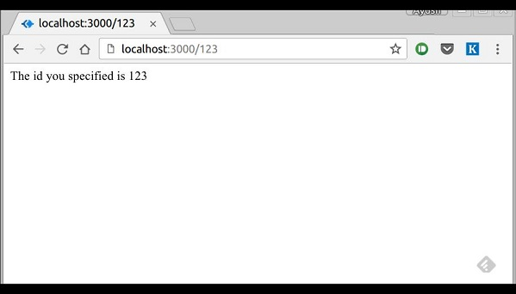
ExpressJS - Routing

Slide 73
Topic Objective
Topic : HTTP method of Express, URL binding, middleware function, Serving static files, Express sessions.
In this topic, the students will learn about the methods of express. What are URL binding and middleware funtion. Student will learn regarding sttic files and express session .

Slide 74
HTTP method of Express
GET and POST both are two common HTTP requests used for building REST API's.
GET requests are used to send only limited amount of data because data is sent into header while POST requests are used to send large amount of data because data is sent in the body.
Express.js facilitates you to handle GET and POST requests using the instance of express.
Get method facilitates you to send only limited amount of data because data is sent in the header. It is not secure because data is visible in URL bar.

Slide 75
GET METHOD EXAMPLE
Fetch data in paragraph format
File: index.html
1.<html>
2.<body>
3.<form action="http://127.0.0.1:8000/get_example2" method="GET">
4.First Name: <input type="text" name="first_name"/> <br/>
5.Last Name: <input type="text" name="last_name"/><br/>
6.<input type="submit" value="Submit"/>
7.</form>
8.</body>
9.</html>

Slide 76
GET Method Cont……
File: get_example.js
1.var express = require('express');
2.var app=express();
3.app.get('/get_example2', function (req, res) {
4.res.send('<p>Username: ' + req.query['first_name']+'</p><p>Lastname: '+req.query['last_name']+'</p>');
5.})
6.var server = app.listen(8000, function () {
7. var host = server.address().address
8. var port = server.address().port
9. console.log("Example app listening at http://%s:%s", host, port)
10.})

Slide 77
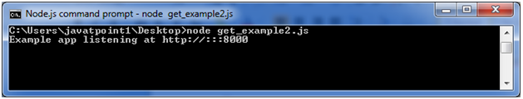
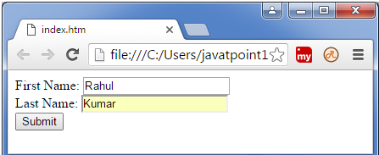
GET Method Cont……

Slide 78
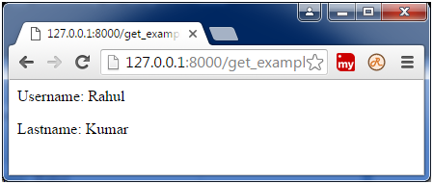
GET Method Cont…….
Output:

Slide 79
Post Method
Post method facilitates you to send large amount of data because data is send in the body.
Post method is secure because data is not visible in URL bar but it is not used as popularly as GET method.
On the other hand GET method is more efficient and used more than POST.

Slide 80
POST Method Cont…….
File: Index.html
1.<html>
2.<body>
3.<form action="http://127.0.0.1:8000/process_post" method="POST">
4.First Name: <input type="text" name="first_name"> <br>
5.Last Name: <input type="text" name="last_name">
6.<input type="submit" value="Submit">
7.</form>
8.</body>
9.</html>

Slide 81
POST Method Cont…….
File: post_example1.js
1.var express = require('express');
2.var app = express();
3.var bodyParser = require('body-parser');
4.// Create application/x-www-form-urlencoded parser
5.var urlencodedParser = bodyParser.urlencoded({ extended: false })
6.app.use(express.static('public'));
7.app.get('/index.html', function (req, res) {
8. res.sendFile( __dirname + "/" + "index.html" );
9.})
10.app.post('/process_post', urlencodedParser, function (req, res) {
11. // Prepare output in JSON format
12. response = {
13. first_name:req.body.first_name,
14. last_name:req.body.last_name
15. };
16. console.log(response);
17. res.end(JSON.stringify(response));
18.})
19.var server = app.listen(8000, function () {
20. var host = server.address().address
21. var port = server.address().port
22. console.log("Example app listening at http://%s:%s", host, port)
23.})

Slide 82
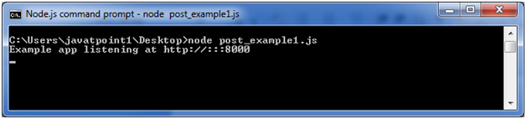
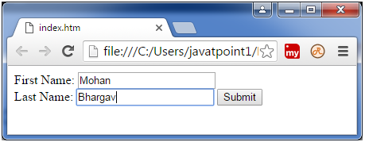
POST Method Cont…….

Slide 83
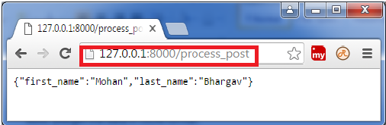
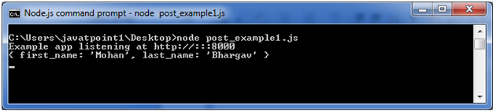
POST Method Cont…….
OUTPUT:
Note: In the above picture, you can see that entries are not visible in the URL bar unlike GET method.

Slide 84
Express.js Middleware
Express.js Middleware
Express.js Middleware are different types of functions that are invoked by the Express.js routing layer before the final request handler.
As the name specified, Middleware appears in the middle between an initial request and final intended route. I
n stack, middleware functions are always invoked in the order in which they are added.
Middleware is commonly used to perform tasks like body parsing for URL-encoded or JSON requests, cookie parsing for basic cookie handling, or even building JavaScript modules on the fly.
Middleware functions are functions that have access to the request object (req), the response object (res), and the next middleware function in the application’s request-response cycle. These functions are used to modify req and res objects for tasks like parsing request bodies, adding response headers, etc.

Slide 85
Express.js Middleware Function
Middleware function
Middleware functions are the functions that access to the request and response object (req, res) in request-response cycle.
A middleware function can perform the following tasks:
It can execute any code.
It can make changes to the request and the response objects.
It can end the request-response cycle.
It can call the next middleware function in the stack.
Used middleware in Express.js app:
Application-level middleware
Router-level middleware
Error-handling middleware
Built-in middleware
Third-party middleware

Slide 86
Express.js Middleware Function Conti....
simple example of a middleware function in action −
var express = require('express');
var app = express();
//Simple request time logger
app.use(function(req, res, next){
console.log("A new request received at " + Date.now());
//This function call is very important. It tells that more processing is
//required for the current request and is in the next middleware
function route handler.
next();
});
app.listen(3000);
The above middleware is called for every request on the server. So after every request, we will get the following message in the console −
A new request received at 1467267512545

Slide 87
ExpressJS - Serving static files
Static files
Files that clients download as they are from the server. Create a new directory, public. Express, by default does not allow you to serve static files.
You need to enable it using the following built-in middleware.
app.use(express.static('public'));
All static files you load will be considering public as root.
To test that this is working fine, add any image file in your new public dir and change its name to "testimage.jpg". In your views, create a new view and include this file like −
html
head
body
h3 Testing static file serving:
img(src = "/testimage.jpg", alt = "Testing Image

Slide 88
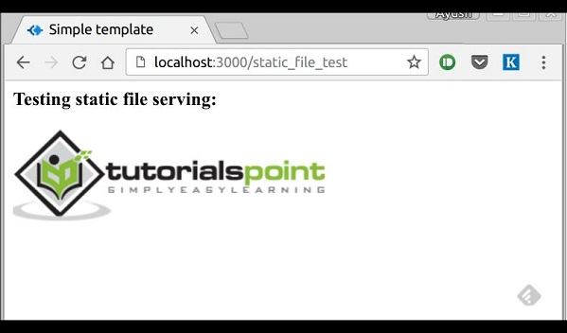
ExpressJS - Serving static files
OUTPUT:

Slide 89
ExpressJS - Session
HTTP is stateless; in order to associate a request to any other request, you need a way to store user data between HTTP requests.
Cookies and URL parameters are both suitable ways to transport data between the client and the server. But they are both readable and on the client side.
Sessions solve exactly this problem. You assign the client an ID and it makes all further requests using that ID. Information associated with the client is stored on the server linked to this ID.

Slide 90
ExpressJS - Session
We will need the Express-session, so install it using the following code.
npm install --save express-session
We will put the session and cookie-parser middleware in place. In this example, we will use the default store for storing sessions, i.e., MemoryStore. Never use this in production environments.
The session middleware handles all things for us, i.e., creating the session, setting the session cookie and creating the session object in req object.
Whenever we make a request from the same client again, we will have their session information stored with us (given that the server was not restarted).
when a user visits the site, it creates a new session for the user and assigns them a cookie.
Next time the user comes, the cookie is checked and the page_view session variable is updated accordingly.

Slide 91
Topic Objective
Topic : REST full API’s, FORM data in Express, document modeling with Mongoose.
In this topic, the students will gain , The idea of REST full API. FORM data usedin Express and document modeling with Mongoose will be cover.

Slide 92
FORM Data
Forms are an integral part of the web.
Almost every website we visit offers us forms that submit or fetch some information for us.
To get started with forms, we will first install the body-parser(for parsing JSON and url-encoded data) and multer(for parsing multipart/form data) middleware.
To install the body-parser and multer, go to your terminal and use −
npm install --save body-parser multer

Slide 93
FORM Data Cont……
After importing the body parser and multer, we will use the body-parser for parsing json and x-www-form-urlencoded header requests, while we will use multer for parsing multipart/form-data.
Create a new view called form.pug
Run your server using the following.
At console; it will show you the body of your request as a JavaScript object

Slide 94
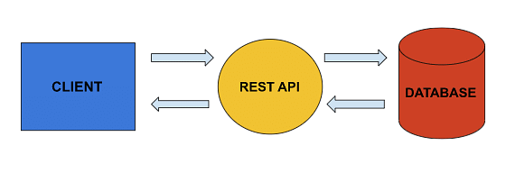
REST API
Introduction:
REST API is the standard way to send and receive data for web services.
A client sends a req which first goes to the rest API and then to the database to get or put the data after that, it will again go to the rest API and then to the client.
Using an API is just like using a website in a browser, but instead of clicking on buttons, we write code to req data from the server.
It's incredibly adaptable and can handle multiple types of requests.

Slide 95
REST API Cont……
What Is REST API?
REST (Representational state transfer) is a popular architecture that is used to create web services.
API (Application Programming Interface is a code that allows two software programs to communicate with each other.
REST API is a software that allows two apps to communicate with one another over the internet and through numerous devices.

Slide 96
REST API Cont……
HTTP Request Types
HTTP Requests are simply messages that are sent by the client to do some tasks on the server
GET - Get command is used to request data from the server, but mainly this method is used to read data
PATCH - This command is used to update, change or replace the data
POST - The post method is used to create new or to edit already existing data
Delete - This delete command is used to delete the data completely from the server

Slide 97
REST API Cont……
API Using Express and Its Architecture :
A request is sent by the client in the form of a JSON file, and with the help of an HTTP request which gets a patch post and delete, it will go to the server first then, the server sends back the response to the client in the form of a message to tell what happened to your request.

Slide 98
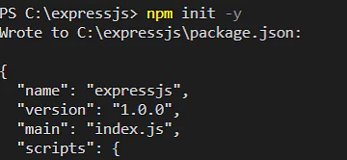
REST API Cont……
Step 1: First, open your editor. Now open your terminal and write a command npm init -y

Slide 99
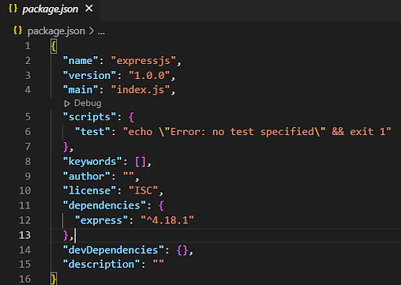
REST API Cont……
Step 1: command npm init -y
This command will create a JSON file

Slide 100
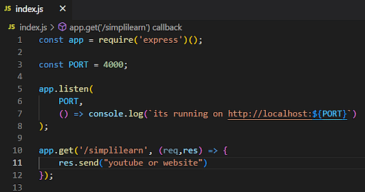
REST API Cont……
Step 2: Now we will install express for that write command
npm install express
Express_REST_API_3
This will install dependencies in the package.json file
Step 3: Now we will create a new file to write all our code index.js
Write a few lines of code in the first line. We will import the express packages

Slide 101

REST API Cont……
This app.listen will respond to the server to listen on a specific port which we have defined already as a variable 4000
Step 5: Then we will write a second argument as a callback to tell the API is working, now lets run this code to check our API is working or node
To run this code, we will write a command node.
Step 6: As our code is running fine, let's open our search engine and write localhost:4000, this will not run,

Slide 102
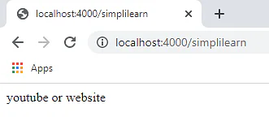
REST API Cont……
Step 7: Now we need an add the second argument here
localhost:4000/simplilearn
Our Simple API is running Successfully

Slide 103
Mongoose Document Model
The Model.create() method of the Mongoose API is used to create single or many documents in the collection. Mongoose by default triggers save() internally when we use the create() method on any model.
Syntax:
Model.create()
Parameters: The Model.create() method accepts three parameters:
docs: It is an object of key-value pair which will be inserted into a collection.
options: It is an object with various properties.
callback: It is a callback function that will run once execution is completed.
Return Value: The Model.create() function returns a promise.

Slide 104
Mongoose Document Model
Setting up Node.js application:
Step 1: Create a Node.js application using the following command:
npm init
Step 2: After creating the NodeJS application, Install the required module using the following command:
npm install mongoose

Slide 105
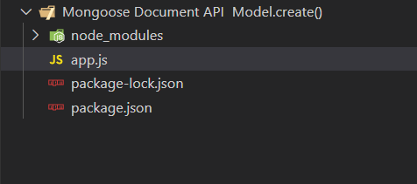
Mongoose Document Model
Project Structure: The project structure will look like this:

Slide 106
Mongoose Document Model
// Require mongoose module
const mongoose = require('mongoose');
// Set Up the Database connection
mongoose.connect(
'mongodb://localhost:27017/geeksforgeeks', {
useNewUrlParser: true,
useUnifiedTopology: true
})
// Defining customerSchema schema
const customerSchema = new mongoose.Schema(
{ name: String, orderCount: Number }
)
// Defining customerSchema model
const Customer = mongoose.model(
'Customer', customerSchema);
// creating document using create method
Customer.create({ name: 'Rahul', orderCount: 5 })
.then(result => {
console.log(result)
})

Slide 107
Mongoose Document Model
Steps to run the program:
To run the application execute the below command from the root directory of the project:
node app.js
Output:
{
name: 'Rahul',
orderCount: 5,
_id: new ObjectId("6304e68407a431f560473ac2"),
__v: 0
}

Slide 108
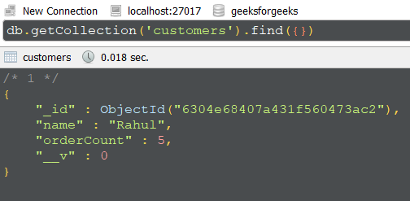
Mongoose Document Model
DATABASE:

Slide 109
Daily Quiz
1) Which of the following command is used to check the current version of NPM?
nmp --ver
npm --version
npm help
None of the above
2) Which of the following method requests that the server accept the data enclosed in the request to modify an existing object identified by the URI?
GET
DELETE
PUT
POST

Slide 110
Daily Quiz
3. Which of the following was the earlier name of the Pug?
Terse
DRY
Express
Jade
4. Which of the following function is used to specify what to do when a get request at the given route is called?
app.get(route, callback)
get(route, callback)
js.get(route, callback)
fun.get(route, callback

Slide 111
Weekly Assignment
Differentiate between GET and POST method.
What do you think are the advantages of middleware function ?
Explain documentation modelling in moongose ?
What is FORM data ?
Describe routing in express js .

Slide 112
Topic Link ( YouTube & NPTEL Video Links)
YouTube /other Video Links
https://youtu.be/rI4kdGLaUiQ?list=PL6n9fhu94yhUbctIoxoVTrklN3LMwTCmd
https://youtu.be/v9ejT8FO-7I?list=PLrhzvIcii6GNjpARdnO4ueTUAVR9eMBpc
https://youtu.be/VGLjQuEQgkI?list=PLt4nG7RVVk1h9lxOYSOGI9pcP3I5oblbx

Slide 113
MCQ (End of Unit)
1) Who is credited as the developer of Express.js?
Larry wall
Rich Hickey
TJ Holowaychuk
Rob Pike
2) Which of the following are the core features of the Express framework?
It allows us to set up middleware to respond to HTTP Requests.
It defines a routing table that can work as per HTTP Method and URL.
It is used to render the HTML pages dynamically.
All of the above.
3) In which of the following year was Express.js initially released?
November 2010
November 2011
December 2010
December 2011

Slide 114
MCQ (End of Unit)
4) Where are the captured values populated regarding the route parameters?
req.data
app.locals
req.params
All of the above
5) How is it possible to create chainable route handlers for a route path in Express.js?
Using app.route()
Using app.routes()
Using app.router()
Using app.routing()

Slide 115
Glossary Questions
Top 10 interview questions
What is Express.js?
What are some distinctive features of Express?
Is Express.js front-end or backend framework?
Why do we use Express.js?
What is the difference between Express.js and Node.js?
Write a code to get post a query in Express.js
What is the difference between Express and Django
How can you deal with error handling in Express.js? Explain with an example
Write the code to start serving static files in Express.js.
What is Middleware in Express.js? What are the different types of Middleware?

Slide 116
Expected Questions for University Exam
What is exppress framework?
How will you install express js?
Explain REST API .
Describe environment variables.
Differentiate between GET and POST method.
What do you think are the advantages of middleware function ?
Explain documentation modelling in moongose ?
What is FORM data ?
Describe routing in express js .
What is URL binding ?

Slide 117
Summary
Till Now we understand, How to Install Node.js and NPM on Windows and Mac. js can be used to design single-page, multi-page, and hybrid web applications and APIs. It allows to set up middleware to respond to HTTP/RESTful Requests.
It defines a routing table to perform different HTTP operations (method and URL).
It allows to dynamically rendering HTML Pages based on passing arguments to templates. It provides high performance because of its ultra-fast I/O. It prepares a thin layer; therefore, the performance is adequate.
Its MVC-like structure makes it organize the web application into MVC architecture. It provides good database support. It supports RDBMS as well as NoSQL databases. Its robust API makes routing easy.

Slide 118
References
Simon Holmes, Clive Herber, “Getting MEAN with Mongo, Express, Angular, and Node”, 2nd Edition 2016, Addison Wesley Publication.
Dhruti Shah, “Comprehensive guide to learn Node.js”, 1st Edition, 2018 BPB Publications.
Christoffer,Noring,Pablo,Deeleman,“Learning Angular”,3rd Edition,2017 Packt publications. .
Peter Membrey, David Hows, Eelco Plugge, “MongoDB Basics”, 2nd edition, 2018, International Publication.
Christoffer Noring, Pablo Deeleman, “Learning Angular”,3rd Edition,

Slide 119
THANK YOU

